Slide 1
Autologous Tissue Separation and Homogenization Device
‘’For You From You ‘’

Slide 2
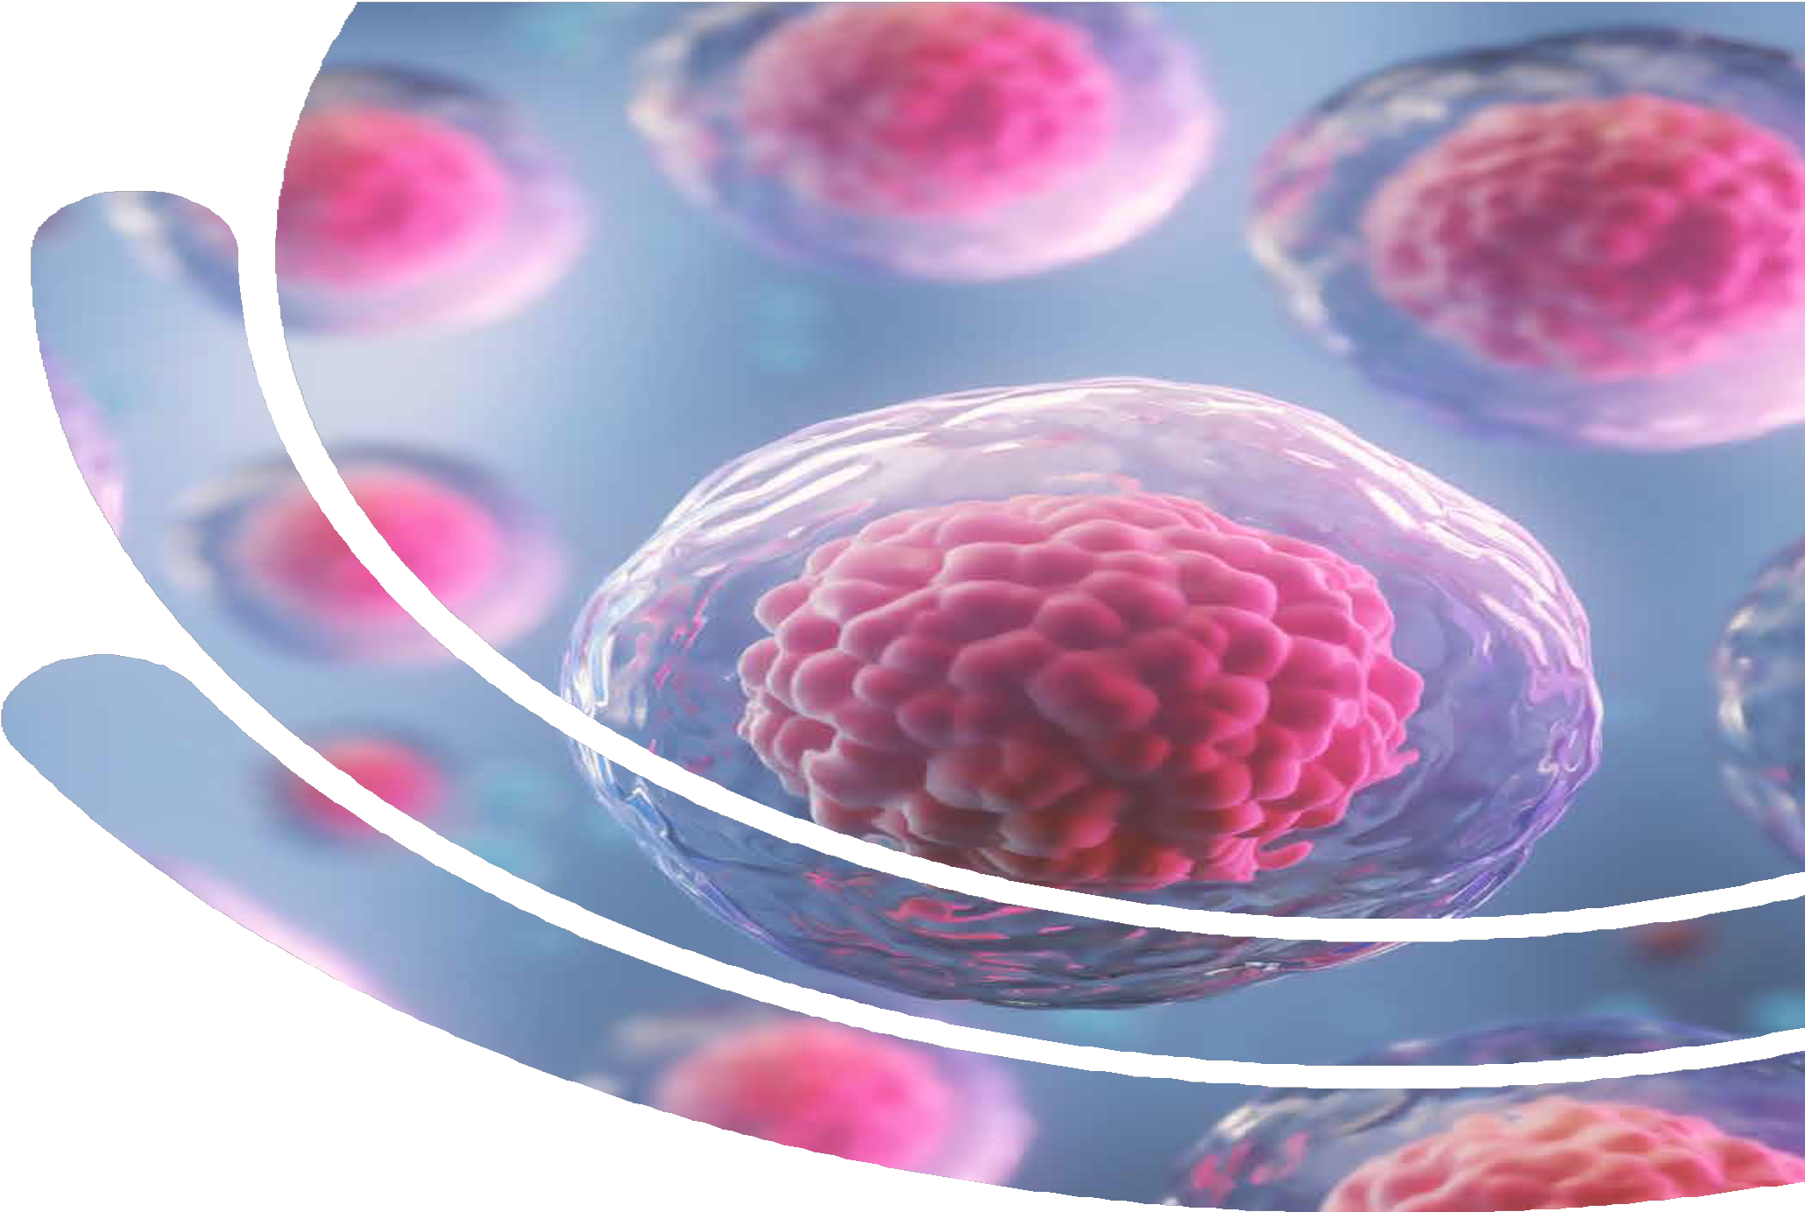
AGENDA
01 02
03
Stem Cell Treatment
GCell Device Technology And Its Advantages
Gcell Genereal Application
04 05
06
Gcell Autologous Micrograft and SVF Cases
Gcell Clinical Studies
Stem Cell Complication Managment

Slide 3
What is Stem Cell Therapy?

Slide 4
What is Stem Cell Therapy?
Stem cell therapy is a novel treatment method that falls under the category of "regenerative medicine applications." These cells are the main cells that can self-renew, proliferate, and differentiate into specific cells needed by the body, both in vivo and in vitro, under suitable conditions without losing their properties.
Stem cells are generally divided into two main categories
Embryonic stem cells
Somatic or adult stem cells.
Embryonic stem cells are found in the early stages of human embryos and theoretically have the ability to differentiate into any cell type in the body, making them pluripotent.
Adult stem cells are found in specific tissues of the body and generally can only differentiate into the cells of their residing tissue.
Overall, stem cell therapy holds great potential for regenerative medicine applications as these unique cells can repair and replace damaged tissues or organs.

Slide 5
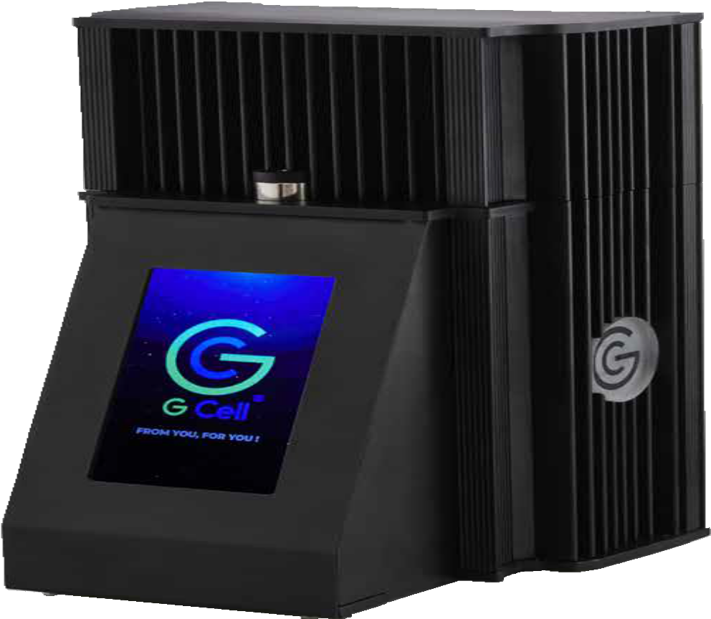
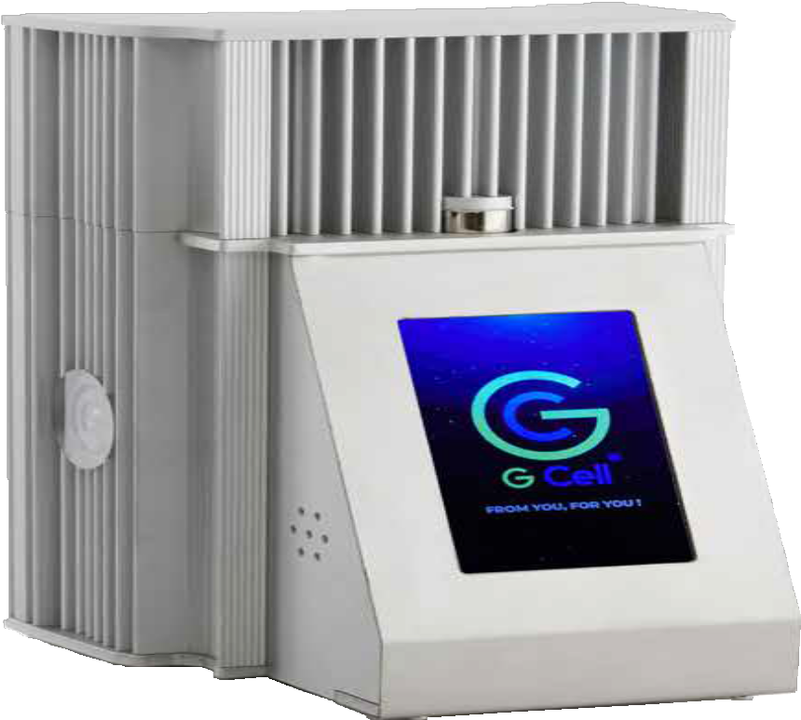
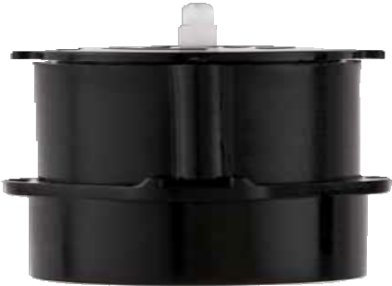
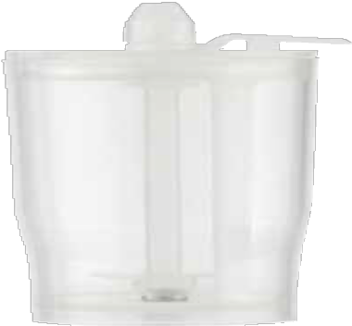
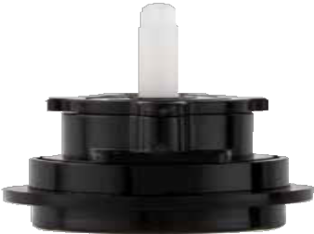
Classification of Stem Cells Based on Differentiation Properties
Totipotent (Omnipotent) Stem Cells
Pluripotent Stem Cells
Oligopotent Stem Cells
Unipotent Stem Cells-(Progenitor Stem Cells)
Multipotent Stem Cells(SVF)

Slide 6
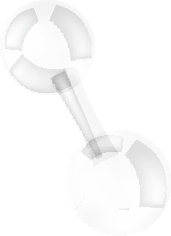
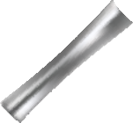
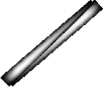
Classification of Stem Cells Based on Differentiation Properties
Autologous MicroGrafting-Unipotent Multipotent Stem Cells-SVF Stem Cells (Progenitor Stem Cells)
Unipotent mesenchymal stem cells are the main cells of connective tissue.
These are precursor cells for mesenchy- mal stem cells and are rich in growth factors, as well as precursor cells for fat cells.
When Mesenchymal Stem Cells (MSCs) are cultured, a fluid remains that con- tains pericytes, lymphocytes, smooth muscle cells, macrophages, endothelial precursor cells, and endothelial cells.
This fluid is called the "Stromal Vascular Fraction (SVF)". The procedure involves injecting the fats taken from adipose tissue into the desired areas.
Unipotent stem cells have the ability to differentiate into a single cell type.
When hair grafts are taken from the scalp, they are transplanted to the balding area. Similarly, fibroblasts taken from the hairless area behind the ear are injected into the bald area

Slide 7
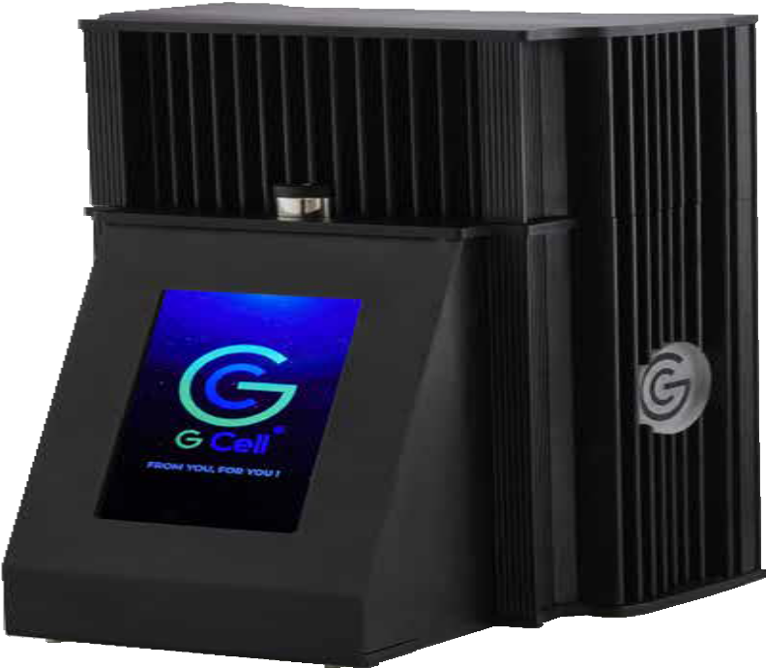
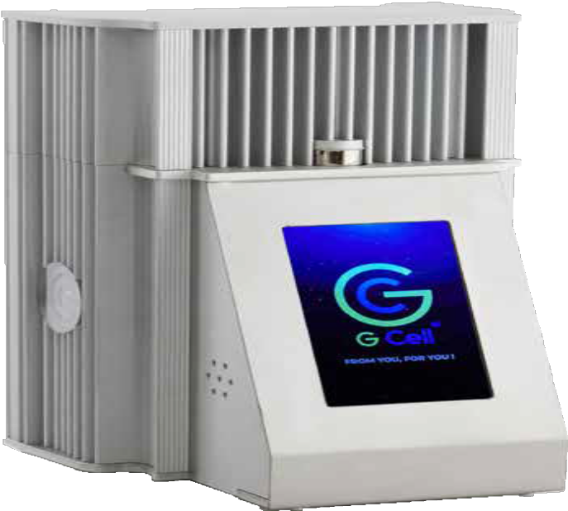
GCell New Generation Autologous
Tissue Separation Device Technology

Slide 8
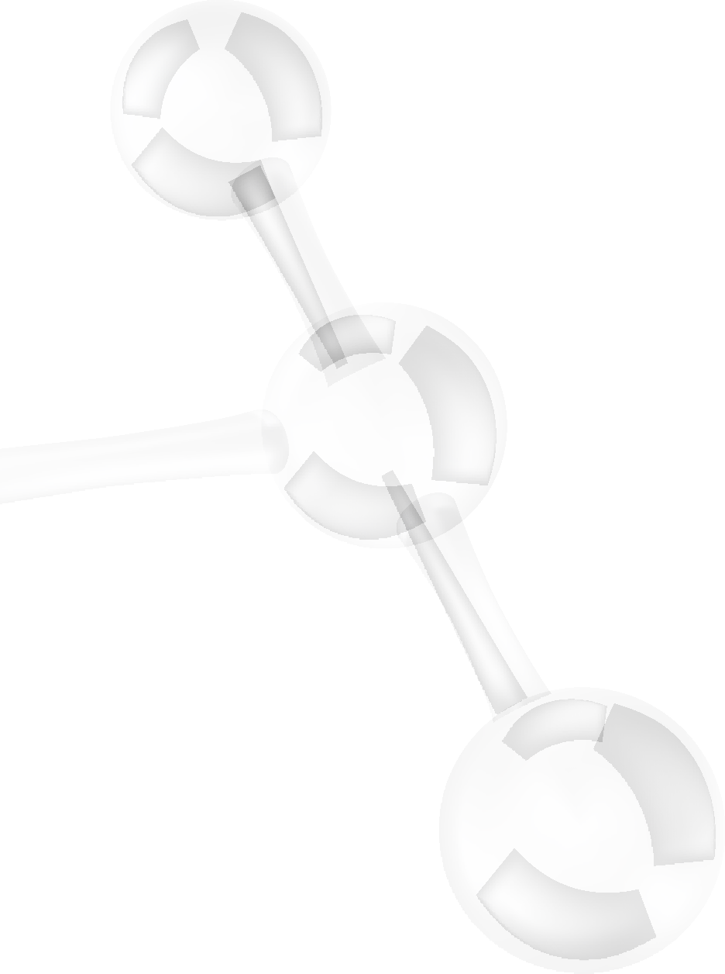
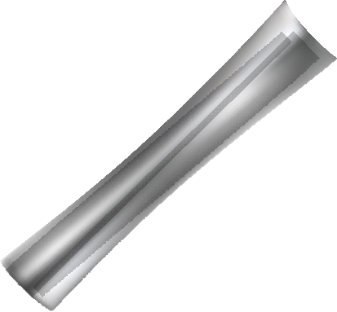
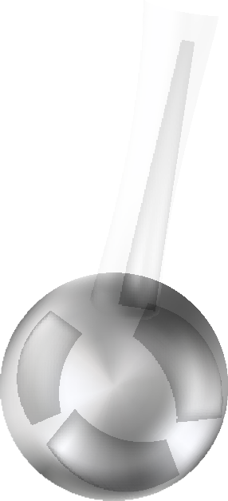
User Friendly
The convenience of being able to perform four procedures in
one device with Autologue Micrograft for Hair Treatment, Fibroblast, SVF, and Photoactivation Procedures (PRP activation only)
01
Advantages of Performing the Procedure in a Clinical Setting:
Clinic-friendly without the need for a hospital setting.
02
03
Naturel Treatment %100 Autologous
Non-enzymatic 100% Organic Autologous Cell Transplantation
Gcell New Generation Device Technology Differences?
High-Tech Gcell Device
Automatic material production using the device
Live cell activation with photoactivation
Effective injection through homogenization
04
05
High patient compliance
one Session
time-effective procedure.
06
FDA Cleared
GCell Device and Kits
07
Ease of use device interface with software effectiveness for
one-click operations.

Slide 9
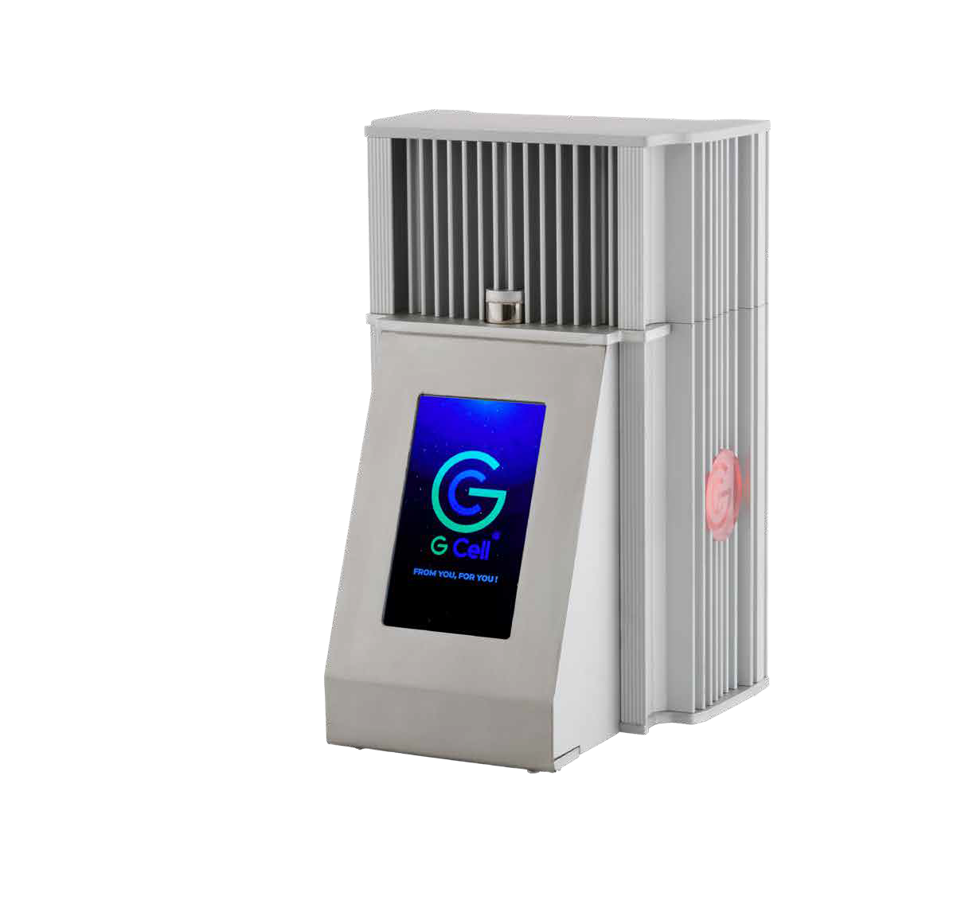
What is GCell Photo Activation and its benefits?
GCell Photo Activation is a feature that enhances the effectiveness of treatment and activates live cells. It has a positive effect on the proliferation and differentiation of mesenchymal stem cells. With GCell Photo Activation, faster results can be achieved.
GCELL photo activation allows for the release of IL1-IL2 receptor antagonists, allowing for colonization. This leads to an increase in regenerative and anti-inflammatory effects in the plasma simultaneously.
A unique feature integrated into the device is the 600-900 N/M Red LED Light, which increases cellular energy production and activates inactive cells. It also stimulates collagen production and accelerates it.
The photo activation process is performed for 10 minutes at 1500 rpm.

Slide 10
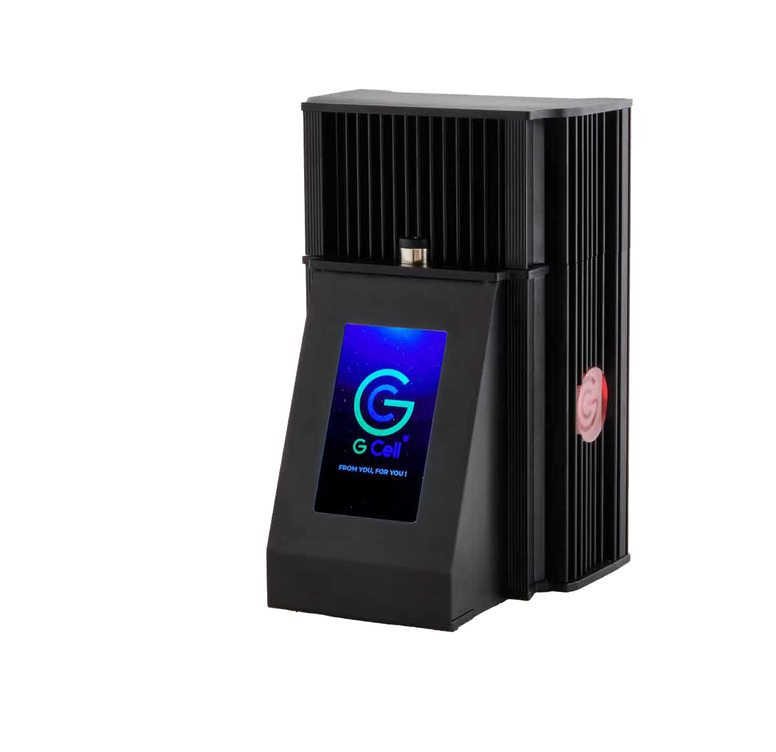
What is GCell Homogenization and What are its Benefits?
The homogenization feature of the GCell® device allows for the separation of cells into smaller particles to obtain a homogeneous cell suspension.
The benefits of homogenization are as follows:
Homogeneous distribution of cells: A homogeneous cell suspension ensures that cells are evenly distributed, resulting in more consistent outcomes during the treatment process.
Accelerated healing process: A homogeneous cell suspension can lead to better healing results when applied to the treatment area. The fragmentation of cells can facilitate their penetration into tissues and accelerate the healing process.
Increased treatment efficacy: Homogenization can enhance the effectiveness of treatment by ensuring a more uniform distribution of various substances (such as drugs, proteins, etc.) used during the procedure.
Cells undergo homogenization for 30 seconds at 1500 RPM.

Slide 11
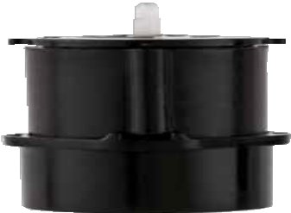
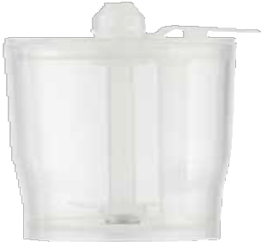
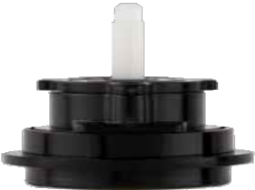
Applications of GCell Next Generation Stem Cell Technology
GCell Autologous Micrograft Hair Treatment
GCell Autologous Micrograft Anti-Aging Treatment
GCell Stromal Vascular Fraction-SVF

Slide 12
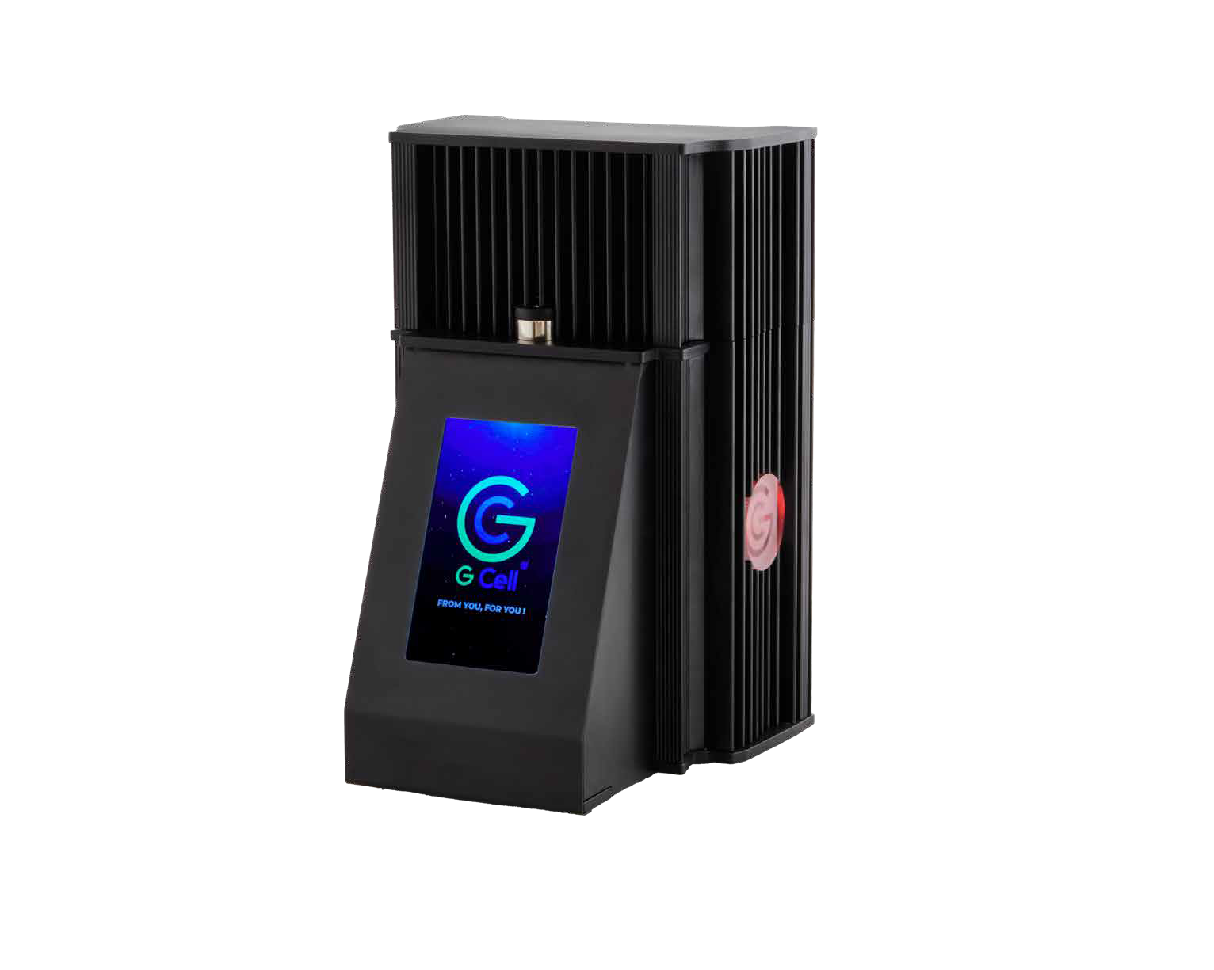
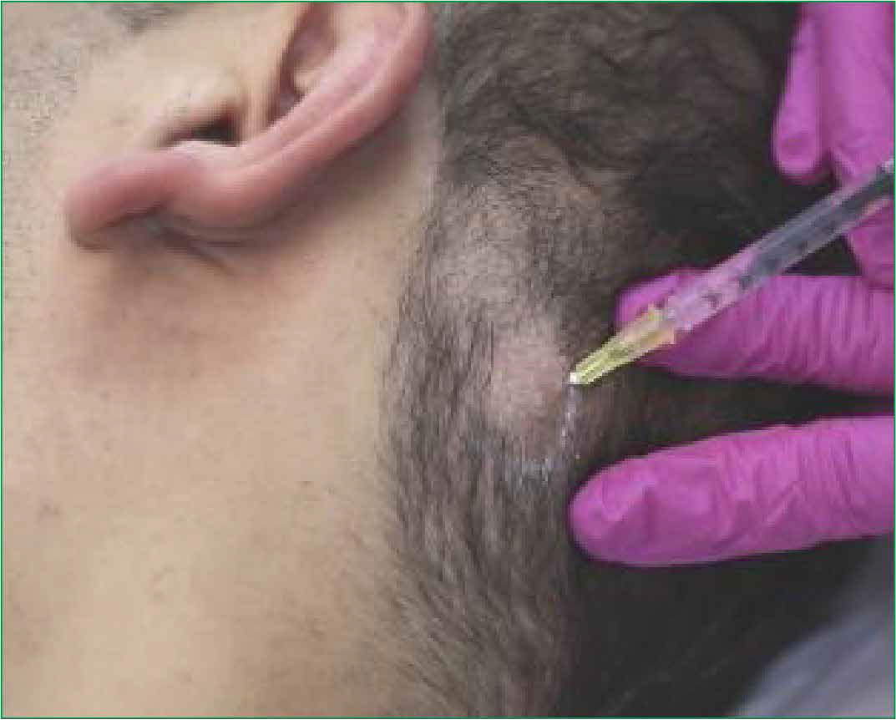
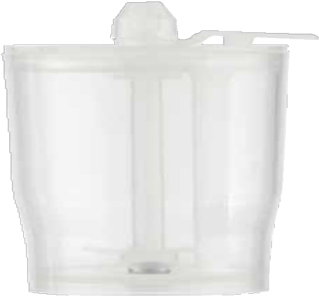
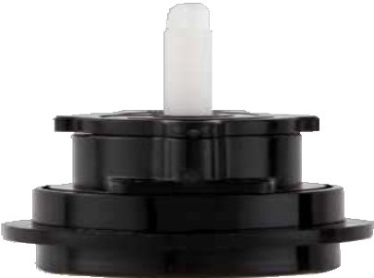
GCell Autologous Micrograft Hair Treatment

Slide 13
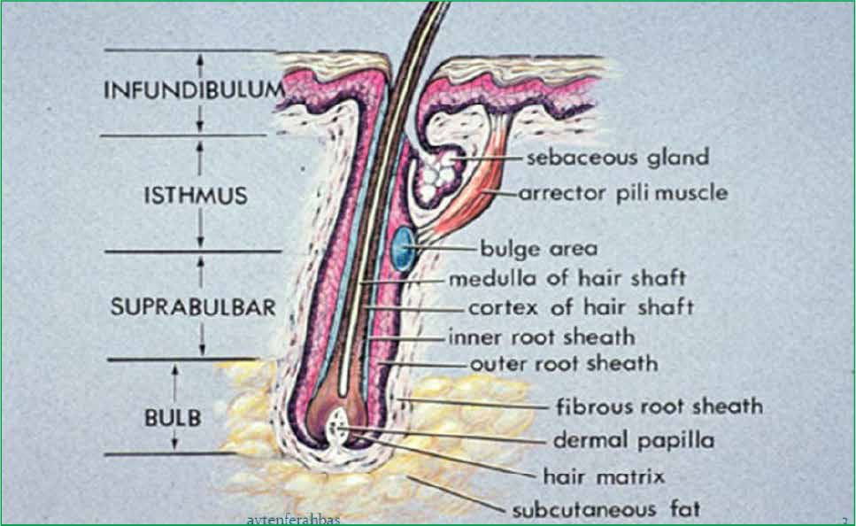
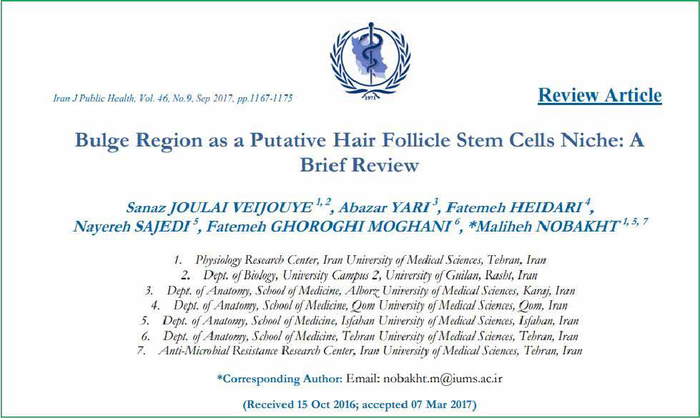
What is the source of hair follicle stem cells, and for which conditions is GCell Hair Treatment recommended?
Hair follicle stem cells are housed within a section called the 'bulge.' The 'bulge' is situated between the mouth of the sebaceous gland and the attachment site of the arrector pili muscle.
These cells constitute all epithelial structures of the skin, including keratinocytes, sebaceous gland cells, and hair.
In the treatment of hair loss,
In the treatment of Androgenetic Alopecia (AGA),
It helps in the treatment of patients with
Alopecia Areata
before, during, and after hair transplantation.

Slide 14
The benefits of GCell Autologous Micrografting Hair Treatment Technology.
%100 otolog transplantasyon100% autologous transplantation
Single-session application
More effective treatment with photoactivation
99% homogenization rate
Real regenerative effect with a high stem cell ratio
Automatic, ultra-sharp blades
Material preparation without manual contact
Faster, more economical
Completely sterile components
Single device, multiple effects, User-friendly

Slide 15
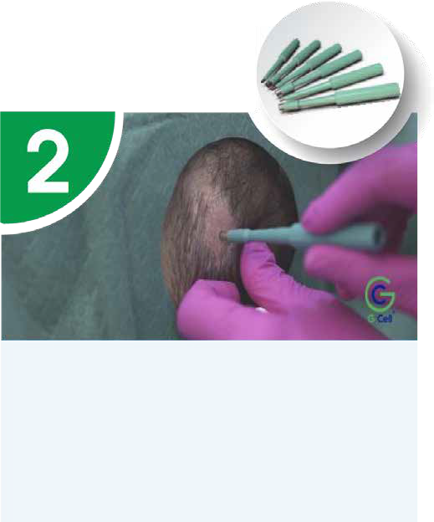
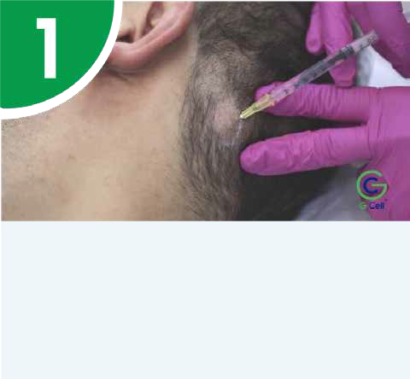
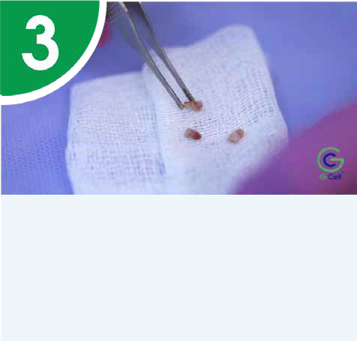
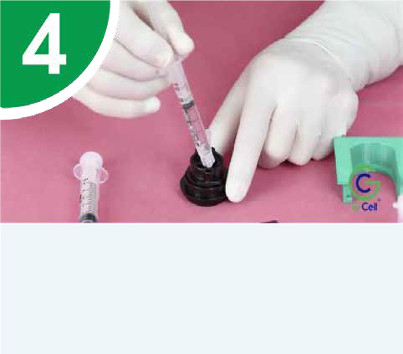
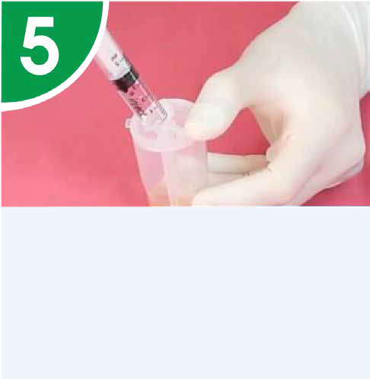
GCell® Autologous Micrograft (Hair) Application Protocol
The hair-bearing area with a diameter of 2 cm behind the ear is shaved. Subsequently, the area is sterilized, and a framed anesthesia is applied to the borders.
4-5 punch biopsies are taken from the area where the procedure will be performed.
The collected biopsies are washed with physiological saline on a sterile gauze.
The collected biopsy materials are placed beneath the blades within the kit. 2.2 ml of physiological saline is added to the kit, and it is positioned in the left chamber of the GCell® device for separation.
The rotation speed during the separation process is 80 rpm.
Following the separation process, the obtained suspension is placed into the homogenization kit. 3 ml of physiological saline is added. It is then positioned in the right chamber of the GCell® device, and the automatic homogenization process is initiated.
*The rotation speed during the homogenization process is 1500 rpm.
After the homogenization process is completed, the kit chamber is not removed before proceeding to the photoactivation process.
Photoactivation is performed with red LED light at a wavelength of 600-900 nm, and the rotation speed is 1500 rpm.

Slide 16
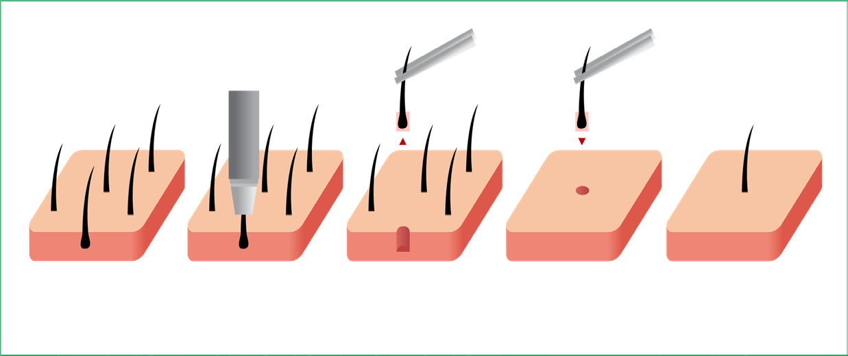
GCell New Generation Autologous Micrograft Technology
The prepared micrograft suspension can be applied by mixing it with PRP.
It can be applied to enhance the success of hair transplantation procedures, either before or after the procedure.
Results start to be observed at 10-12 weeks.
Does Not Replace Hair Transplantation Treatment!

Slide 17
GCell Autologous Micrograft Anti-Aging Treatment

Slide 18
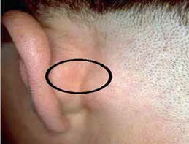
GCell® Autologous Micrograft (Anti-Aging) ApplicationProtocol
The hairless area behind the ear is identified, and a framed anesthesia is applied to the borders after sterilization.
4-5 punch biopsies are taken from the area where the procedure will be performed.
The collected biopsies are washed with physiological saline on a sterile gauze.
The collected biopsy materials are placed beneath the blades within the kit. 2.2 ml of physiological saline is added to the kit, and it is positioned in the left chamber of the GCell® device for separation.
The rotation speed during the separation process is 80 rpm.
Following the separation process, the obtained suspension is placed into the homogenization kit. 3 ml of physiological saline is added. It is then positioned in the right chamber of the GCell® device, and the automatic homogenization process is initiated.
*The rotation speed during the homogenization process is 1500 rpm.
After the homogenization process is completed, the kit chamber is not removed before proceeding to the photoactivation process.
Photoactivation is performed with red LED light at a wavelength of 600-900 nm, and the rotation speed is 1500 rpm.

Slide 19
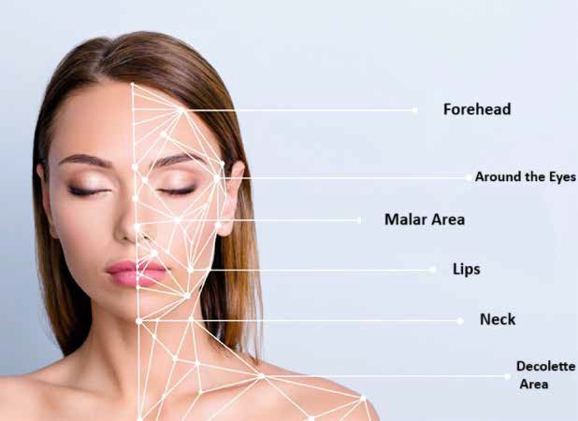
Application Areas
Procedures are performed using Fibrocell obtained from the hairless area behind the ear.
Using the same device procedures as GCell autologous hair treatment, injections are administered to the required application area.

Slide 20
GCell Next Generation Stem Cell Technology for SVF Applications

Slide 21
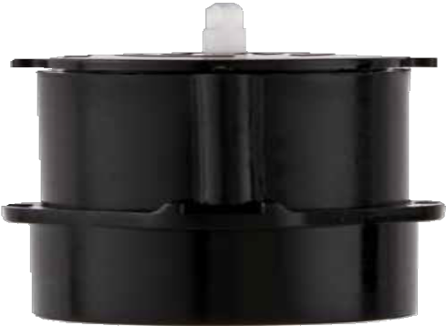
GCell Next Generation Stem Cell Technology for SVF Applications
Stromal Vascular Fraction-SVF (Multipotent Stem Cells)
Stromal Vascular Fraction (SVF) stem cells, also known as adipose tissue-derived stem cells or stromal vascular fraction (SVF) cells, are derived from abdominal fat or other fat tissues.
Due to their ability to transform into various cell types, these cells have the potential to be used in various tissue repair and regeneration applications.

Slide 22
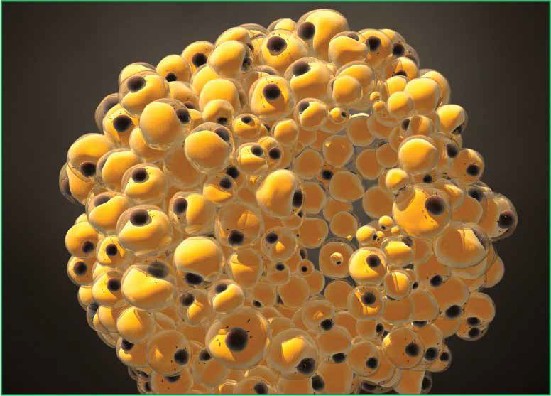
GCell Next Generation Stem Cell Technology for SVF Applications
Adipose tissue (fat tissue) is a rich source for obtaining mesenchymal stem cells through the SVF method.
GCell® enables non-enzymatic extraction of stem cells.
100% autologous transplantation
Single-session application
Faster, more economical stem cell extraction
Non-enzymatic (no additives)
Completely sterile components
More effective treatment with photoactivation

Slide 23
Why GCell SVF?
Gcell Application
This procedure can be applied in a polyclinic setting.
Local anesthesia is sufficient.
Only 15 ml of fat tissue is required.
There is an approximate preparation time of 40 minutes.
It does not require washing or centrifugation. There is no risk of chemical contamination.
It is a cost-effective application.
Cellular recovery is achieved through photoactivation.
There is an opportunity for natural plumpness.
It can be mixed with PRP. GCELL SVF production technology.
Tumesan Application
This procedure can be performed in a hospital setting.
General anesthesia is required.
A sample of 100-150 ml is taken.
Chemicals used for separation need to be washed.
It requires a two-hour duration.
It is a costly procedure.

Slide 24
GCell® SVF Application Protocol
After sterilizing the abdominal area, local anesthesia is applied.
A lipoaspiration kit is prepared under sterile conditions
(a cannula is attached to the tip of the syringe, and a stoppe is placed at the back.)

Slide 25
GCell® SVF Application Protocol
A few millimeters of skin is incised with a scalpel from the right or left lower quadrant.
The lipoaspiration kit is inserted into the subcutaneous fat tissue. By withdrawing the plunger, negative pressure is created,
and it is locked with a stopper to maintain negative pressure.

Slide 26
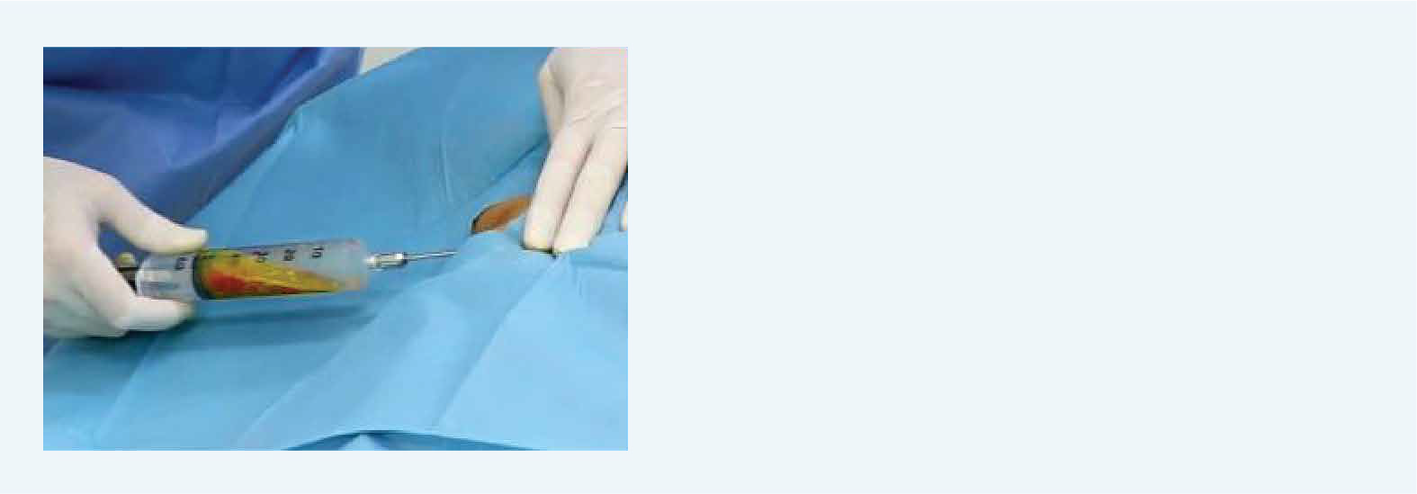
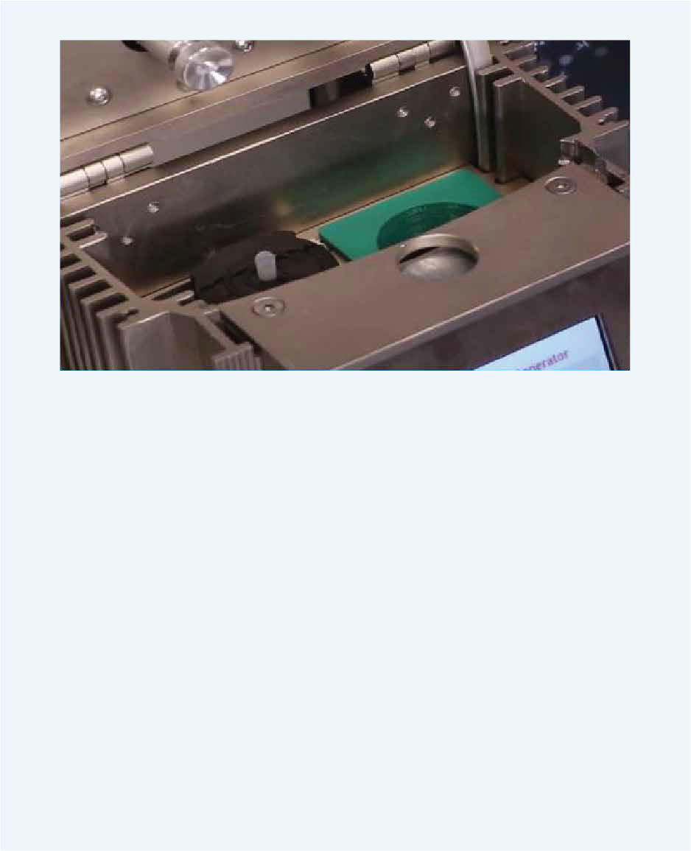
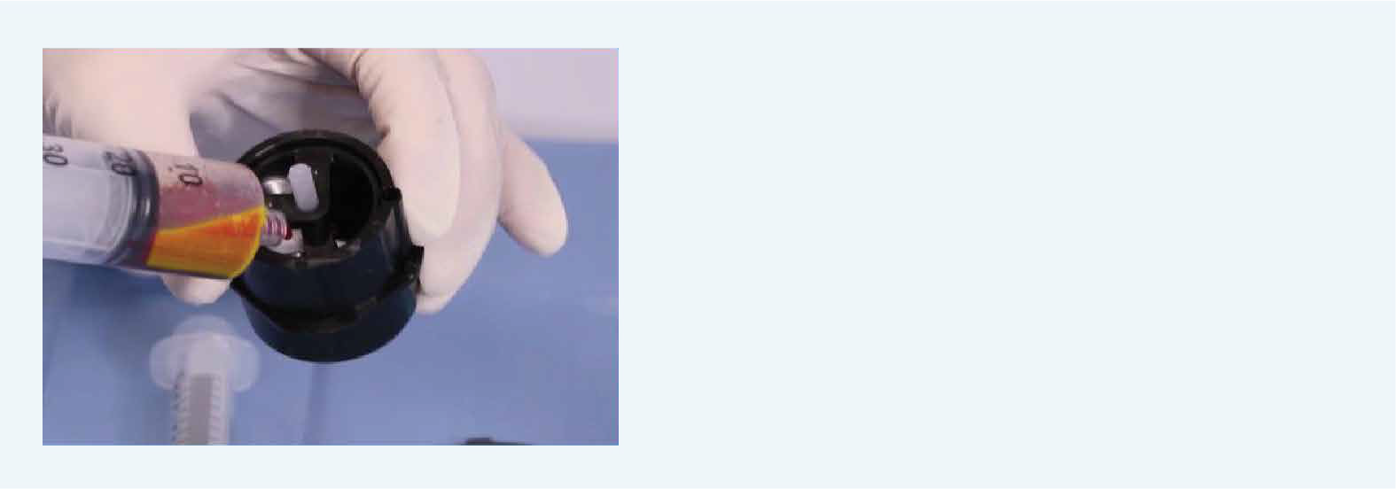
GCell® SVF Application Protocol
Approximately 15 ml of sample is taken from the subcutaneous
fat tissue in the abdominal region.
It is positioned in the left chamber of the GCell® device for separation.
The collected 15 ml subcutaneous fat tissue sample is placed into the GCell® fat kit.
Approximately 5-7 ml of SVF is obtained from the 15 ml fat tissue.
*The rotation speed during the separation process is 100 rpm.

Slide 27
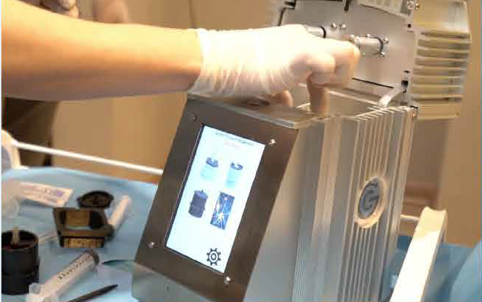
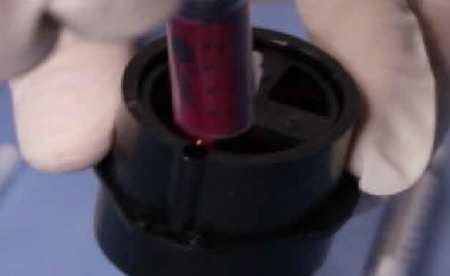
GCell® SVF Application Protocol
The syringe for photoactivation is placed in the right chamber of the GCell® device. Once the photoactivation process is complete, the application can be performed in the desired area.
Photoactivation is carried out with red LED light at a wavelength of 600-900 nm.
If desired, it can be combined with material taken from subcutaneous fat tissue for ﬁller purposes.

Slide 28
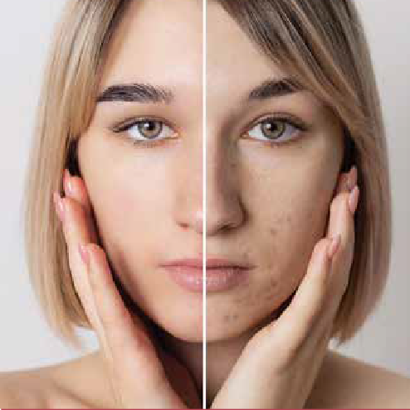
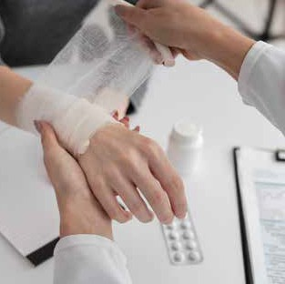
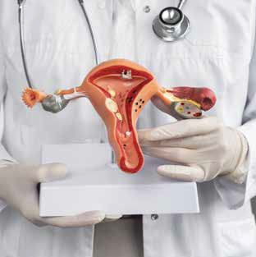
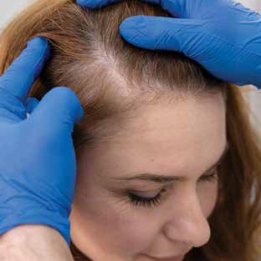
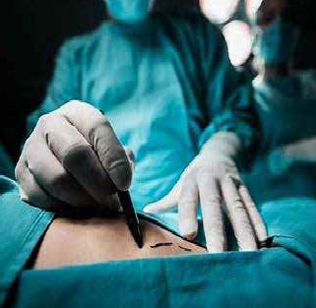
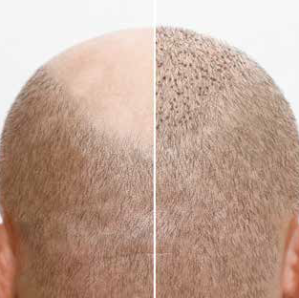
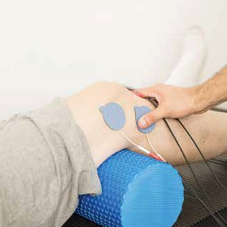
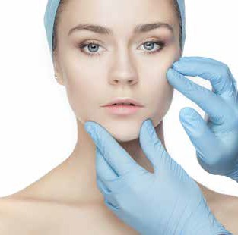
GCell SVF Therapeutic Areas
Cosmetic Gynecology
Dermatology Wound Care Urology
Hair Loss Treatment
Hair Transplant
Orthopedics
Physical Therapy
Medical Aestetics
Plastic Surgery
Beyond Disciplines

Slide 29
GCell Autologous Micrograft Hair Case Examples

Slide 30
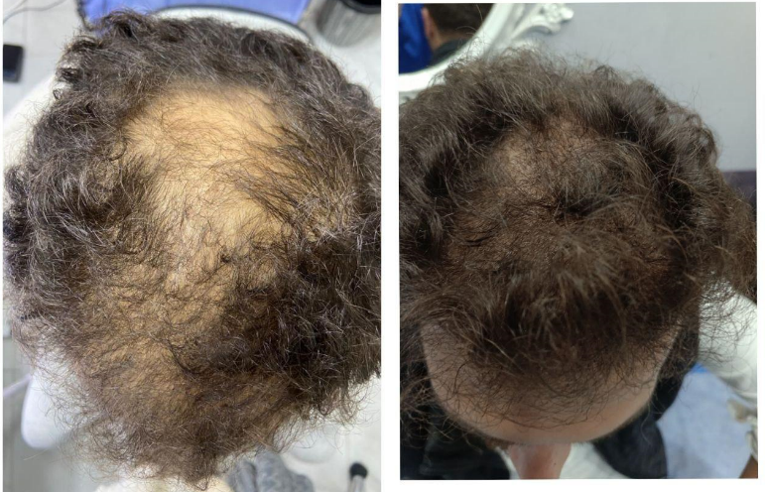
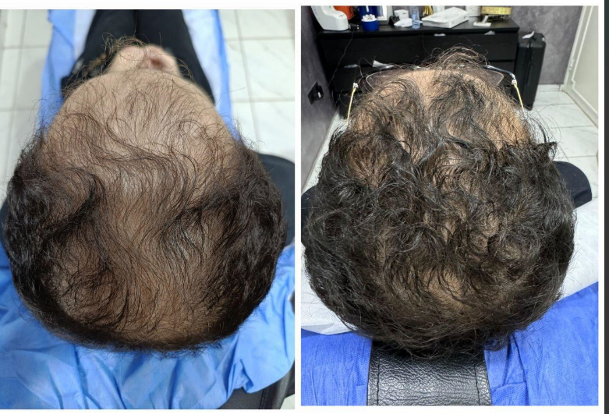
AFTER
GCell Autologous Micrograft Hair Case Examples
BEFORE
AFTER
BEFORE
GCell New Generation Autologous Micrograft
Treatment 4th-month result
20 y-M
GCell New Generation Autologous Micrograft
Treatment 4th-month result
42 y-M

Slide 31
AFTER
GCell Autologous Micrograft Hair Case Examples
BEFORE
AFTER
BEFORE
GCell New Generation Autologous Micrograft
Treatment 2th month result
36 y-M
GCell New Generation Autologous Micrograft
Treatment 1th month result
41 y-W

Slide 32
AFTER
GCell Autologous Micrograft Hair Case Examples
BEFORE
AFTER
BEFORE
GCell New Generation Autologous Micrograft
Treatment 2th month result
43 y-W
GCell New Generation Autologous Micrograft
Treatment 3th month result
39 y-M

Slide 33
AFTER
GCell Autologous Micrograft Hair Case Examples
BEFORE
AFTER
BEFORE
GCell New Generation Autologous Micrograft
Treatment 3th month result
42 y-M
GCell New Generation Autologous Micrograft
Treatment 1st month result
43 y-W

Slide 34
AFTER
GCell Autologous Micrograft Hair Case Examples
BEFORE
AFTER
BEFORE
GCell New Generation Autologous Micrograft
Treatment 3th month result
41 y-F
GCell New Generation Autologous Micrograft
Treatment 4th-month result
38 y-F

Slide 35
AFTER
GCell Autologous Micrograft Hair Case Examples
BEFORE
AFTER
BEFORE
GCell New Generation Autologous Micrograft
Treatment 4th month result
42 y-M
GCell New Generation Autologous Micrograft
Treatment 5th-month result
39 y-W

Slide 36
AFTER
GCell Autologous Micrograft Hair Case Examples
BEFORE
AFTER
BEFORE
GCell New Generation Autologous Micrograft
Treatment 4th month result
42 y-W
GCell New Generation Autologous Micrograft
Treatment 2th month result
32 y-W

Slide 37
GCell SVF Cases Examples

Slide 38
GCell SVF Cases Examples
BEFORE
AFTER
BEFORE
AFTER
38 Year Old Female Patient
51 Year Old Female Patient

Slide 39
GCell SVF Cases Examples
BEFORE
AFTER
BEFORE
AFTER
37 Year Old Female Patient
39 Year Old Female Patient

Slide 40
GCell SVF Cases Examples
BEFORE
AFTER
BEFORE
AFTER
43 Year Old Female Patient
42 Year Old Female Patient

Slide 41
GCell SVF Cases Examples
BEFORE
AFTER
BEFORE
AFTER
34 Year Old Female Patient
36 Year Old Female Patient

Slide 42
GCell SVF Cases Examples
BEFORE
AFTER
BEFORE
AFTER
41 Year Old Female Patient
29 Year Old Female Patient

Slide 43
GCell Clinical Studies

Slide 44
Clinical Studies with GCell - Autologous Micrograft Study in AGA Patients
Data from the autologous hair follicle micrograft study conducted at the Department of Dermatology, Cerrahpaşa Faculty of Medicine.
A total of 46 patients aged 18 and above with androgenetic alopecia were included in the study (Age range: 21-53). *Severity of alopecia according to the Hamilton Classification:
14 patients were in stage 3,
26 patients were in stage 4,
6 patients were in stage 5.
From each patient, 4 tissue samples were taken using punch biopsy and subjected to separation, homogenization, and photoactivation processes in the GCell Tissue Separation and Homogenization Device. The obtained solution was injected 5 mm deep into the hairless areas of the scalp.
**After a 24-week follow-up, hair parameters (pre- and post-treatment) were compared using TrichoScan® (Teachscreen Software; Fotofinder, Bad Birnbach, Germany).
IMCAS 2023, poster No: 123432

Slide 45
Clinical Studies with GCell - Autologous Micrograft Study in AGA Patients

Slide 46
Comparative Clinical Study: GCell vs. Regenera
Results:
In the GCell® Tissue Separation Device, it was found that 21% more viable cells were obtained compared to Regenera.

Slide 47
Comparative Clinical Study: GCell vs. Regenera
In both devices, tissue samples exhibited similar biological characteristics under comparable conditions after tissue processing.

Slide 48
Clinical Studies with GCell - SANATDER GUIDELINES
GCell Autologous Micrograft Treatment is recommended in the SANATDER Guidelines.

Slide 49
Live Stem Cell Count Clinical Study - GCell

Slide 50
Live Stem Cell Count Clinical Study - GCell
43,6 * 0,0519 = 2,26 million live stem cells
CD 90: Thy-1 –Mesenchymal Stem cell marker CD 105: Endoglin-Mesenchymal Stem cell marker CD 34: Hematopoietic stem cell marker
CD 14: Macrophage marker
CD 45: Leukocyte marker

Slide 51
Clinical Studies with GCell SVF - Knee Osteoarthritis
Objective: The aim of this study is to evaluate the safety and efficacy of intra-articular stromal vascular fraction (SVF) injection in patients with symptomatic knee osteoarthritis during mid-term (3-year) follow-up.
Knee Surgery, Sports Traumatology, Arthroscopy https://doi.org/10.1007/s00167-023-07555-0

Slide 52
Clinical Studies with GCell SVF - Knee Osteoarthritis
Using the same SVF preparation kit;
In SVF aspirates obtained under local anesthesia, the live cell count was determined to be 4.4x10⁷ (44 million) cells per ml, In SVF aspirates obtained under tumescent anesthesia, the live cell count was found to be 2.6x10⁷ (26 million) cells per ml.
Knee Surgery, Sports Traumatology, Arthroscopy https://doi.org/10.1007/s00167-023-07555-0

Slide 53
Clinical Studies with GCell SVF - Knee Osteoarthritis
Findings: During the initial 2-year follow-up, a statistically significant improvement (p<0.05) was observed in VAS, WOMAC, and Lysholm scores compared to the baseline.
Knee Surgery, Sports Traumatology, Arthroscopy https://doi.org/10.1007/s00167-023-07555-0

Slide 54
Clinical Studies with GCell SVF - Knee Osteoarthritis
In knees with grade 2-3 osteoarthritis, intra-articular SVF injection reduced pain and significantly improved functional outcomes in the first 2 years; however, these positive effects of the injection diminished in the third year.
Therefore, considering that intra-articular SVF injection may improve the symptoms of knee osteoarthritis in the early stages but may not have a positive impact on medium and long-term outcomes, the repetition of SVF injection or consideration of advanced treatment options may be contemplated.
Knee Surgery, Sports Traumatology, Arthroscopy https://doi.org/10.1007/s00167-023-07555-0

Slide 55
Stem Cell Complication Management

Slide 56
Stem Cell Complication Management
Autologous stem cell therapy is a treatment method that involves using stem cells obtained from the patient's own body.
Complications related to external factors, such as the risk of infection and reactions that may occur against the immune system, may be lower.
The risk of complications varies for each patient, and individuals undergoing autologous stem cell therapy generally face lower risks since there is a lower probability of compatibility issues when using stem cells obtained from their own bodies.
Goncharov, E.N.; Koval, O.A.; Igorevich, E.I.; Encarnacion Ramirez, M.D.J.; Nurmukhametov, R.; Valentinovich,
K.K.; Montemurro, N. Analyzing the Clinical Potential of Stromal Vascular Fraction: A Comprehensive Literature Review. Medicina 2024, 60, 221.

Slide 57
Stem Cell Complication Management
Autologous stem cell therapy with SVF is evaluated in a recent study.
SVF therapy was observed for 10 different medical applications, namely skin quality and scar improvement, osteoarthritis, tendinopathy, TMJ disorders, wound healing, androgenic alopecia, perianal fistula, migraine and vocal fold scarring.
Overall, SVF therapy resulted in good/excellent outcomes, with few or no adverse events.
Among the 1443 patients, only in 50 (3.46%) were complications observed, mostly related to the liposuction procedure. Most complications were minor and resolved without any medical intervention.
Ghiasloo, Mohammad, et al. "Expanding clinical indications of mechanically isolated stromal vascular fraction: a systematic review." Aesthetic surgery journal 40.9 (2020): NP546-NP560.

Slide 58
Which Conditions Can Lead to Complications?
Infection: There may be a risk of infection in the areas where stem cells are collected or applied. In this case, it is crucial to follow appropriate sterilization and hygiene measures.
Bleeding: Bleeding may occur during or after the stem cell collection process. Individuals with clotting issues should be particularly careful.
Allergic Reaction: Although rare, some patients may experience allergic reactions to the administration of stem cells.
Yang F, Ji Z, Peng L, Fu T, Liu K, Dou W, et al. (2021) Efficacy, safety and complications of autologous fat grafting to the eyelids and periorbital area: A systematic review and meta-analysis. PLoS ONE 16(4): e0248505

Slide 59
Complication Management and Stem Cell Patient Education Pre-Procedure Patient Assessment
By obtaining a medical history and inquiring about the patient's previous illnesses, it should be determined if there is an unsuitable history for stem cell application, such as a history of cancer or autoimmune disease. If the patient has an inappropriate medical history, the procedure should not be performed.
The medications the patient is currently taking should be identified by asking about the patient's health history to determine suitability for the procedure. If deemed unsuitable, the patient should be informed, and the procedure should not be carried out.
If the patient is deemed suitable for the procedure, a detailed explanation of the process should be provided, and an informed consent form should be signed by the patient.
Ghiasloo, Mohammad, et al. "Expanding clinical indications of mechanically isolated stromal vascular fraction: a systematic review." Aesthetic surgery journal 40.9 (2020): NP546-NP560.

Slide 60
Contraindications for Autologous Stem Cell Procedure
The autologous stem cell procedure involves the extraction of stem cells from an individual's own body and their re-administration to the same person. However, as with any medical procedure, there are certain situations in which the autologous stem cell procedure cannot be applied or requires careful evaluation. Here are some situations where the autologous stem cell procedure may not be recommended:
Active Cancer
Severe Advanced Organ Failure
Serious Heart and Lung Issues
Severe Infections:
Serious Autoimmune Diseases
Eldery People:
Mental Health Issues
Pregnancy:
Each patient is unique, and therefore, the decision regarding autologous stem cell treatment should be made by a healthcare professional, taking into consideration the patient's overall health, medical history, and specific condition. This decision should be reached through a detailed assessment conducted between the patient and the doctor.
N. Saba et al. Overview of autologous stem cell transplantation , Critical Re6iews in Oncology/Hematology 36 (2000) 27–48

Slide 61
Complication Management Processes
Rapid Assessment
Symptom Management
Patient Monitoring
Supportive Care
Surgical Intervention
N. Saba et al. Overview of autologous stem cell transplantation , Critical Re6iews in Oncology/Hematology 36 (2000) 27–48

Slide 62
Autologous Stem Cell Complication Case Studies
Adipose tissue-derived lipoaspiration (fat suction) procedure may lead to complications such as bruising in the abdominal area. To manage such situations, the following complication management processes are recommended:
Cold Compression and Elevated Positioning:
Pain and Inflammation Control:
Drainage:
Improving Circulation:
Bleeding Control:
Hematoma Management:
Physical Therapy and Rehabilitation
Wederfoort et al. Donor site complications and satisfaction in autologous fat grafting for breast reconstruction: A systematic review. J Plast Reconstr Aesthet Surg. 2022 Apr;75(4):1316-1327.

Slide 63
Autologous Stem Cell Complication Case Studies
Cold Compression and Elevated Positioning
Anti-Inflammatory and Analgesic Medications
Topical Corticosteroids
Hyaluronidase Injections
Physical Therapy and Lymphatic Drainage Massage
Drainage Procedures
Under-Eye Care
Wederfoort et al. Donor site complications and satisfaction in autologous fat grafting for breast reconstruction A systematic review. J Plast Reconstr Aesthet Surg. 2022 Apr;75(4):1316-1327.
Birben AÖ, Kutlubay Z, Engin B, Serdaroğlu S. Dermalfiller Applications in Dermatology and Complications. Dermatoz 2020;11(2):14-20

Slide 64
Autologous Stem Cell Complication Case Studies
Autologous micrograft hair treatment may rarely lead to complications. In the event of complications, the following medical procedures are recommended:
Infection Control
Swelling and Pain Control
Drainage Procedures
Wound Care
Use of Antibacterial Shampoo
Corticosteroid Creams
Limitation of Physical Activities
Wederfoort et al. Donor site complications and satisfaction in autologous fat grafting for breast reconstruction: A systematic review. J Plast Reconstr Aesthet Surg. 2022 Apr;75(4):1316-1327.
Birben AÖ, Kutlubay Z, Engin B, Serdaroğlu S. Dermalfiller Applications in Dermatology and Complications. Dermatoz 2020;11(2):14-20

Slide 65
Thank You
‘’For You From You ‘’

